Slide 1
Inferences

Slide 2
What could he be thinking?
Is what you said an explanation to the question above?
Then you made an inference!

Slide 3
Definition of Inferences:
Conclusions based on observations. Inferences try to explain the observations made. Inferences are your opinion on why something happened.

Slide 4
Lets try to make our own inferences about these pictures…

Slide 6
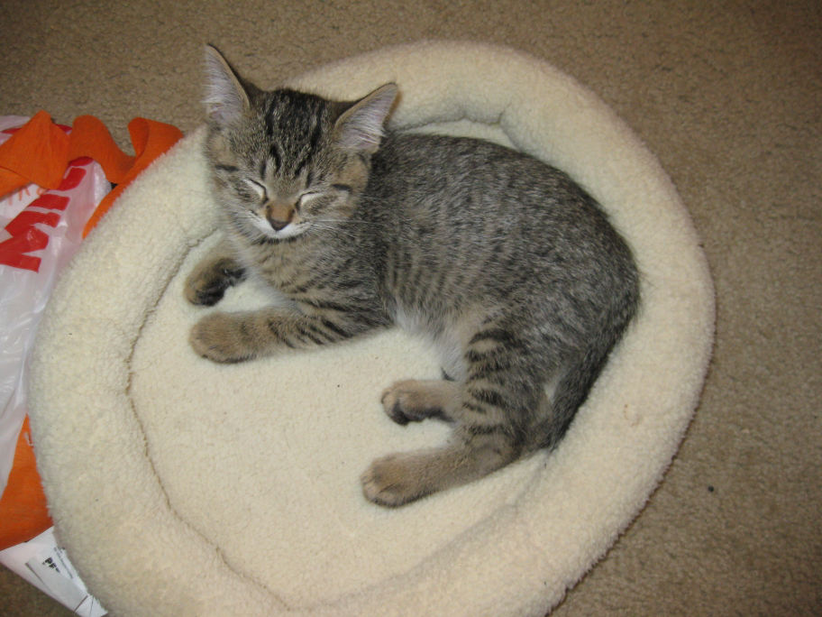

Slide 7
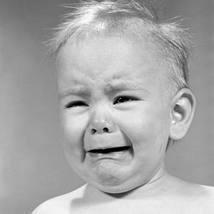

Slide 8
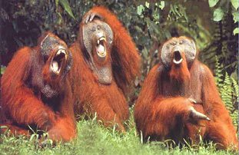

Slide 9
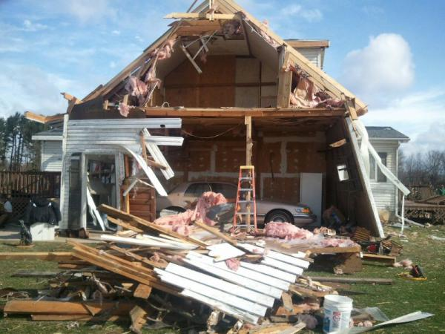

Slide 10
Type 2 Writing
A) what is the difference between a qualitative and quantitative observation?
B)Make one observation
& inference About
this picture
.

